Slide 1
GEOG 392/676 GIS Programing Lab3
Zhenlei Song, Ph.D Student
Department of Geography
Email: songzl@tamu.edu
Office: CSA 301F

Slide 2
Lab 3 Tasks
Load dataset using GeoPandas
Implement a Census Tract Class
Calculate Population Density and add results as a new column

Slide 3
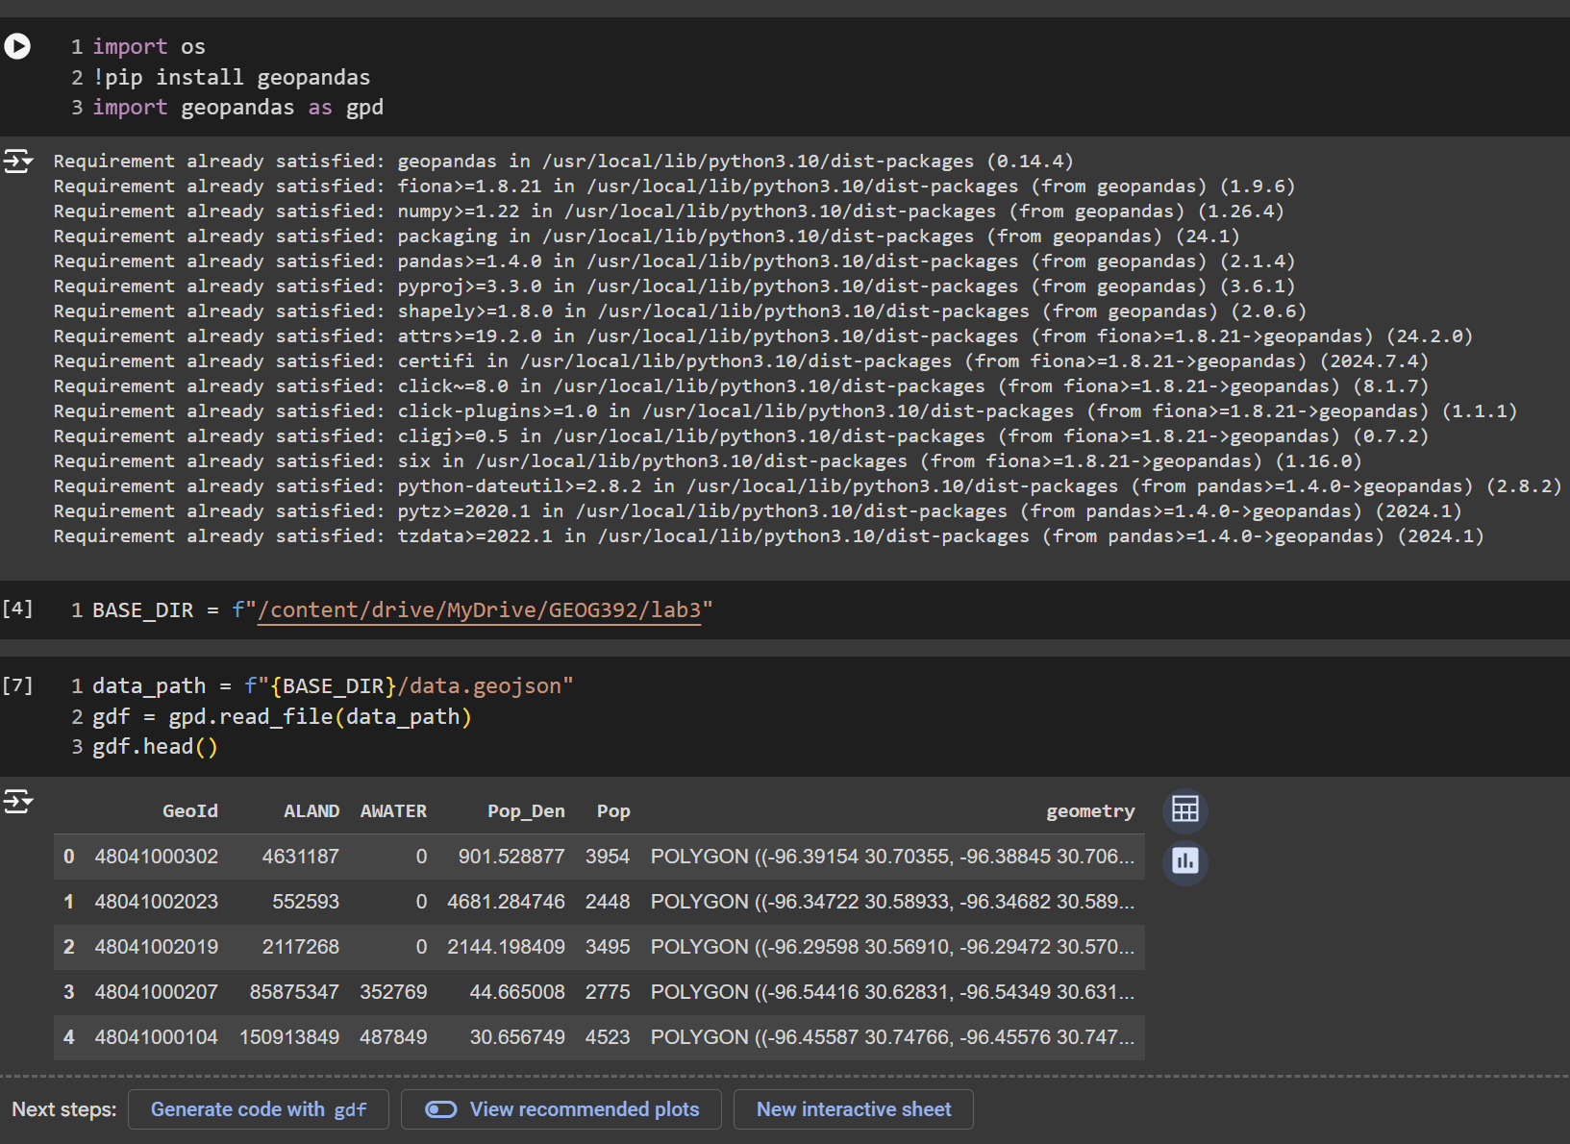
Load dataset
GeoPandas

Slide 4
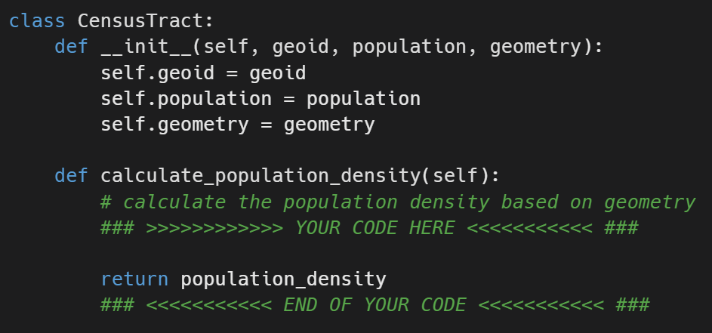
Census Tract Class
Class Definition
Hints:
Pop density = pop / area
Get `area` by calling GeoPandas.GeoSeries.area
Find `area` methods from `Shapely.Geometry.Polygon` class
Doc can be found here

Slide 5
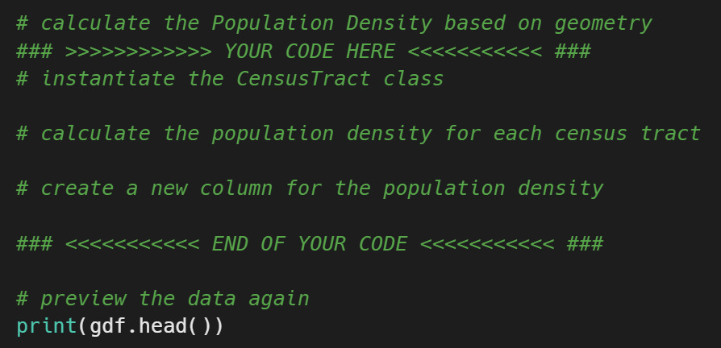
Calculate Population Density
Code Template
Hints:
Option 1:
iterate through all rows
Instantiate CensusTract class for each row
Call `calculate_population_density` method for each row
Option 2:
Use `apply` and/or `lambda` functions to get a new column
Locate columns:
`<GeoDataFrame>[<column_name>]`
Set columns:
`<GeoDataFrame>[<column_name>] = <new_column_values>`

Slide 6
Submission
Submit a PDF file includes:
Screenshots of all your codes
Screenshots of the running results
Link to your Github Repo
Grading Rules:
30 points for the CensusTract class definition.
30 points for the population density calculation.
20 points for adding the new column.
10 points for the code quality and docstring.
10 points for Github repository.

Slide 7

Additional Resources
Useful Links
GeoPandas Docs
Pandas Docs
Shapely Docs
Census Bureau County Codes
VS Code Plugins
Python
Pylance
Python Debugger
Gitlens

Slide 8
The End

